Slide 2
Microsoft Edge, a break from the past
Clemens Schotte
Technical Evangelist

Slide 3
Time | Min. | Session
10:00 – 10:05 | 5 | Welcome
10:05 – 10:30 | 25 | Session 1 - Microsoft Edge, a break from the past
10:30 – 11:15 | 45 | Session 2 - Innovations of the web
11:15 – 11:45 | 30 | Session 3 - Modern front-end tooling in Visual Studio
11:45 – 12:30 | 45 | HOL - Modern front-end tooling in Visual Studio (part 1)
12:30 – 13:30 | 60 | Lunch
13:30 – 14:00 | 30 | HOL - Modern front-end tooling in Visual Studio (part 2)
14:00 – 14:30 | 30 | Session 4 - Introduction to ASP.NET Core & Visual Studio Code
14:30 – 15:00 | 30 | HOL - Introduction to ASP.NET Core 1.0
15:00 – 15:15 | 15 | Break
15:15 – 16:00 | 45 | Session 5 - Introduction to Azure for web developers
16:00 – 16:50 | 50 | HOL - Getting started with Azure App Service Web Apps
16:50 – 17:00 | 10 | Conclusion

Slide 4

A fork from the past

Slide 5
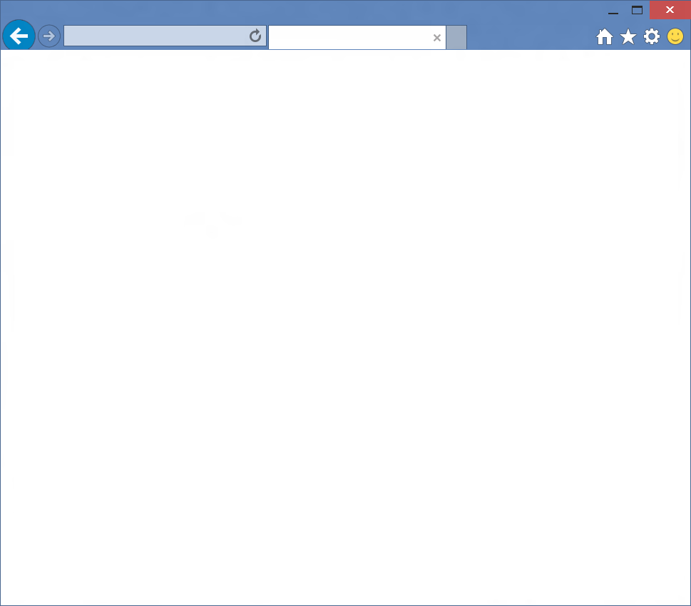

Browser
Internet Explorer
Web Platform
Trident

Slide 6
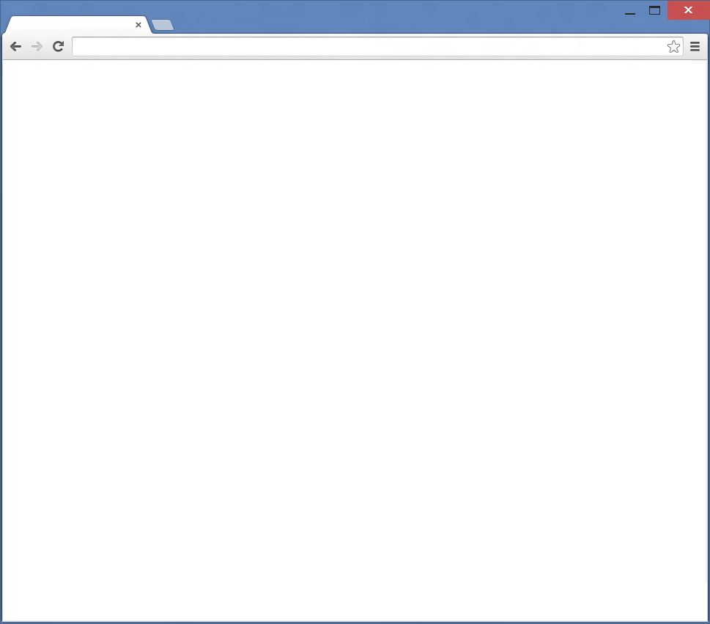

Browser
Chrome
Web Platform
Blink

Slide 7
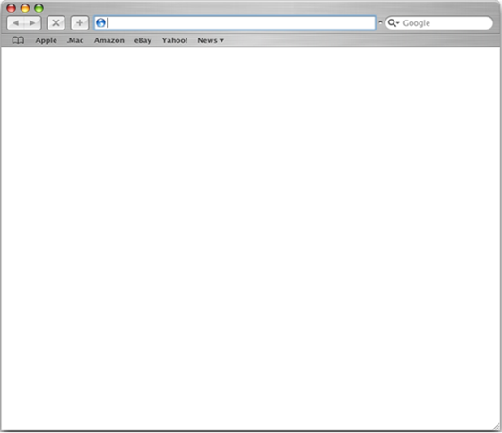

Browser
Safari
Web Platform
Webkit

Slide 8
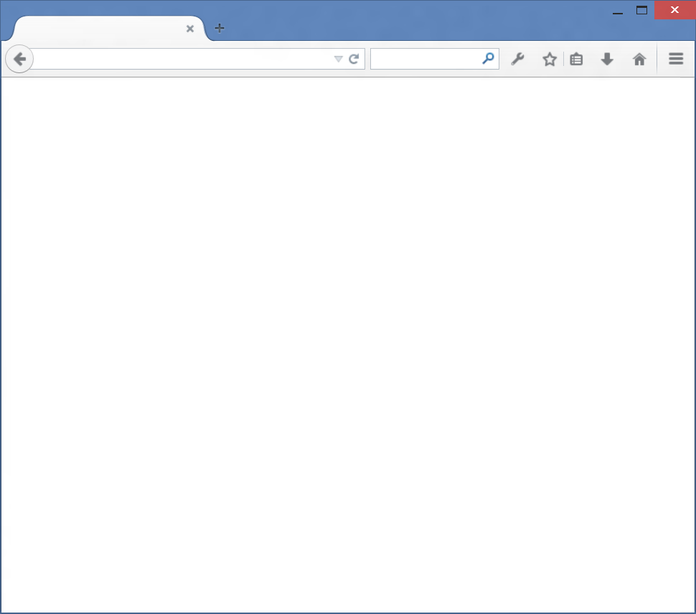

Browser
Firefox
Web Platform
Gecko

Slide 9
1995
2015
1
2
3
4
4.x
5
5.5
6
7
8
9
9
10
11
Trident

Slide 10

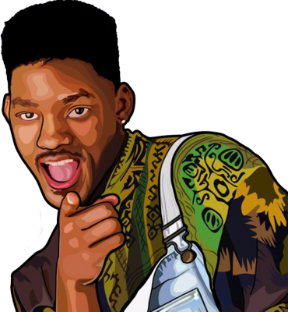

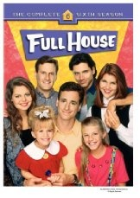
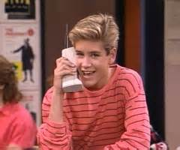
1995 was 20 years ago…

Slide 11

HTML4, ES3, CSS2
1995
1995
2015
1
2
3
4
4.x
5
5.5
6
7
8
9
9
10
11
Trident
Quirks
Strict
!DOCTYPE

Slide 12

Modern Web
HTML5, SVG, ES5, CSS3
Legacy Web
CSS2.1
HTML4, ES3, CSS2
1995
2015
1
2
3
4
4.x
5
5.5
6
7
8
9
9
10
11
Trident
IE5
Quirks
IE7
Compat View
IE8
Standards Mode
EMIE
Enterprise Mode
!DOCTYPE
x-ua-compatible
IE9
Standards Mode
IE10
Standards Mode
QME
Quirks Mode Emulation
IE11
Standards Mode

Slide 13









11
E
Always up-to-date
Update frequently
Single doc model
Always up-to-date
Update frequently
Single doc model
10
9
8
7
Q
14
12
13
33
34
35
5

Slide 14

11
E
Ever Green Engine
Update frequently
Single doc model
Always up-to-date
Update frequently
Single doc model
Ever Green Engine
Update frequently
Single doc model
10
9
8
7
Q
14
12
13
33
34
35
5

Slide 15
Mobile Chromium usage across forks
Chromium 28 – 27%
Chromium 33 – 6%
Chromium 35 – 1%
Chromium 38 – 1%
Chromium 40 – 39%
Chromium versions
<10
Chromium 39 – 3%
Chromium 37 – 2%
Chromium 30 – 1%
Chromium 30 – 18%
Chromium 18 - 2%
Source: www.quirksmode.org/blog/archives/2015/02/counting_chromi.html

Slide 16
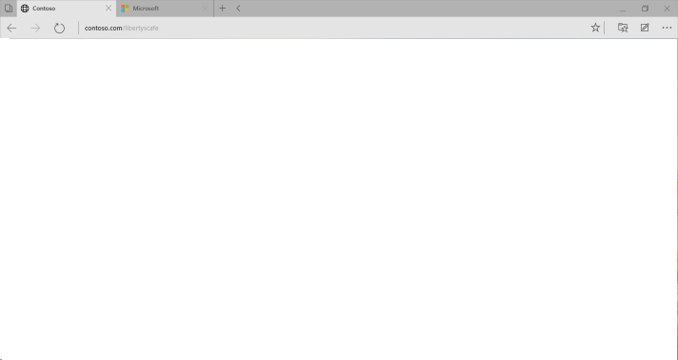
Microsoft Edge
Microsoft EdgeHTML
Evergreen

Slide 17
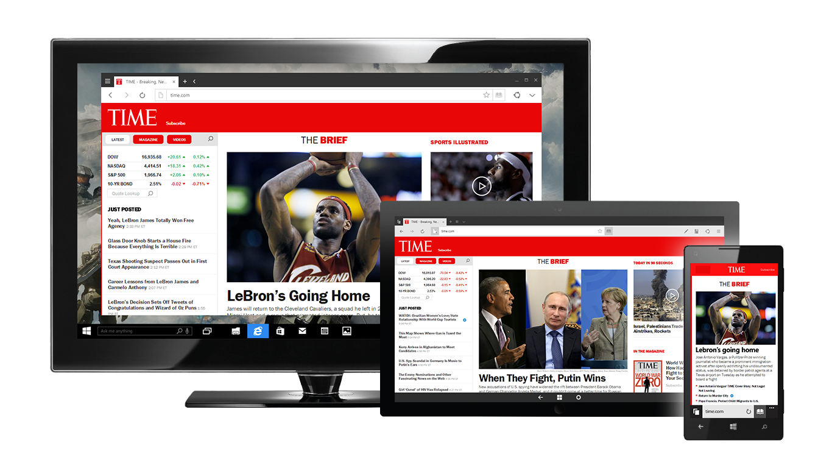

Slide 18
“The web should just work for everyone – users, developers, and businesses.”

Slide 19
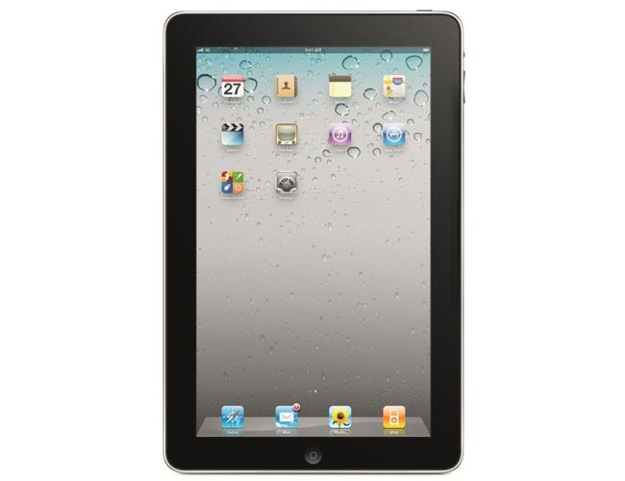
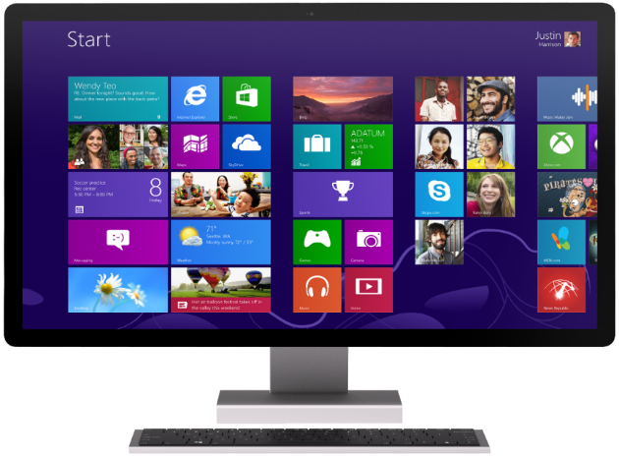
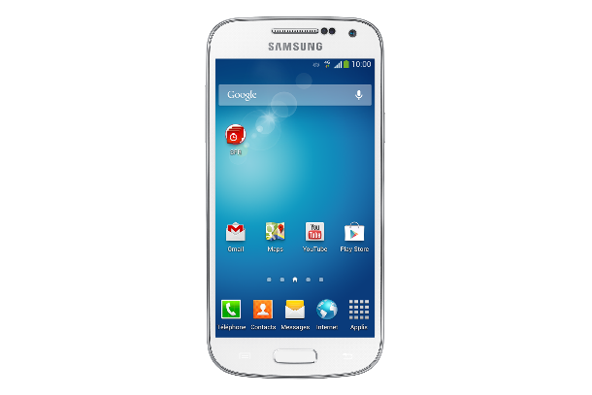
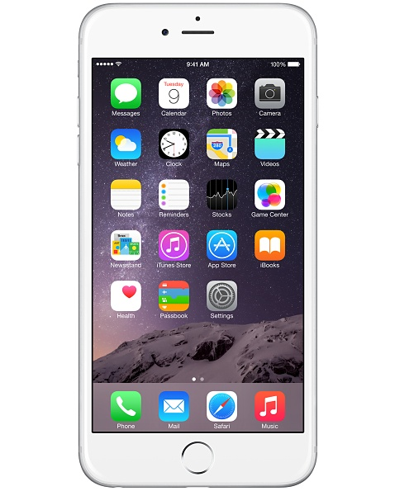
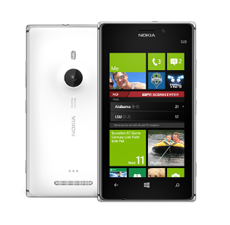
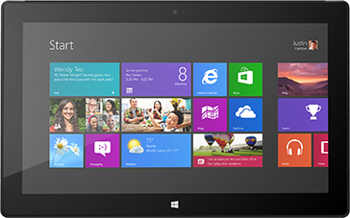
The web is on a wider variety of devices than ever
The dream: Write once, run anywhere

Slide 20
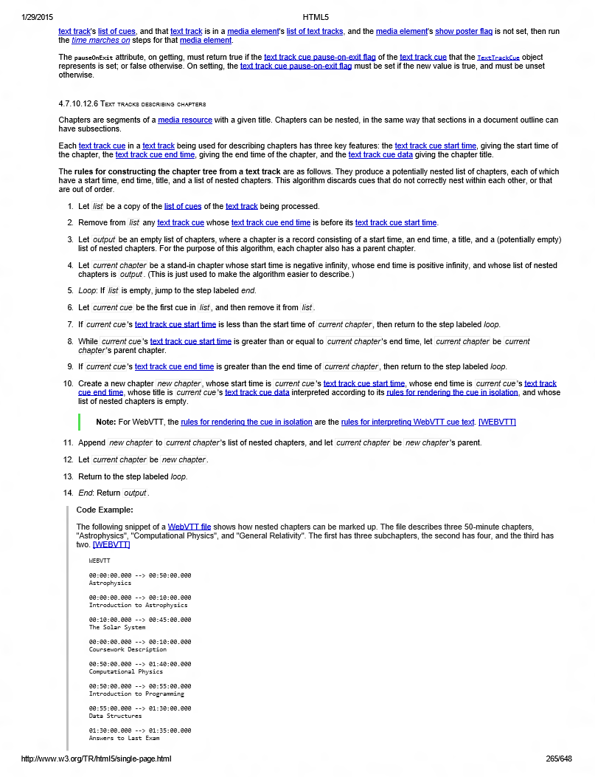
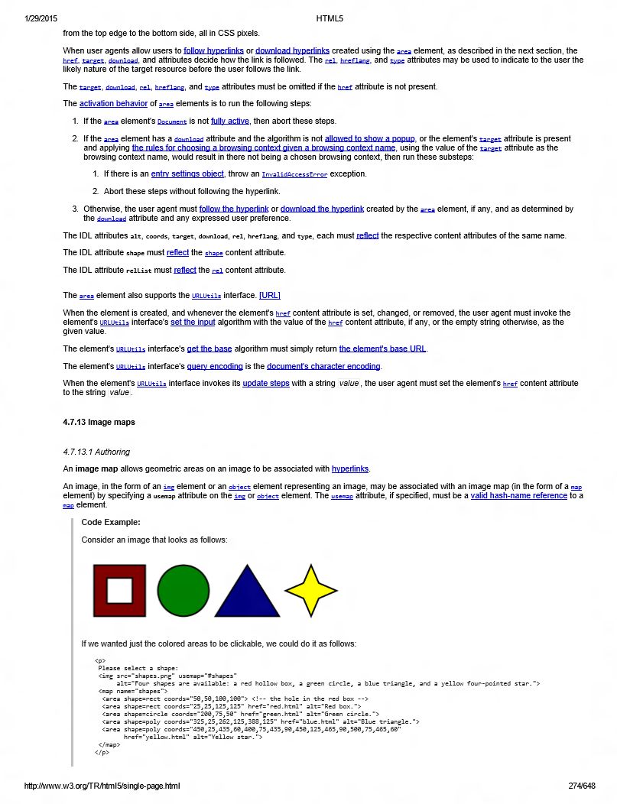
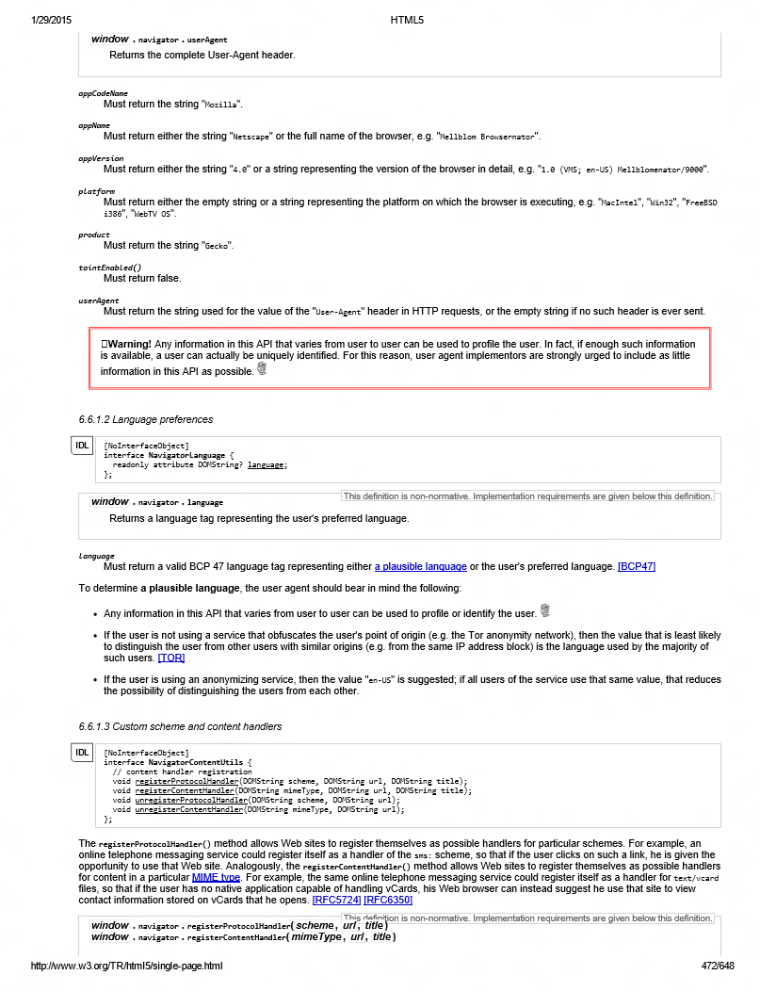
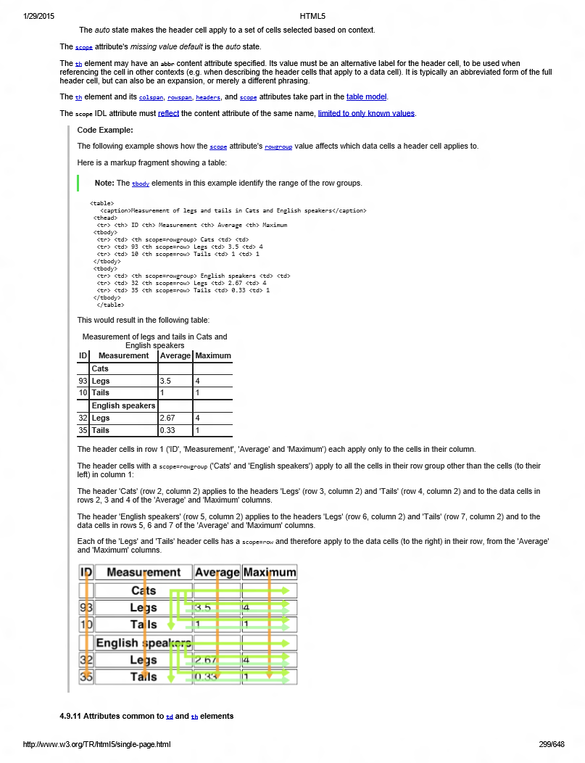
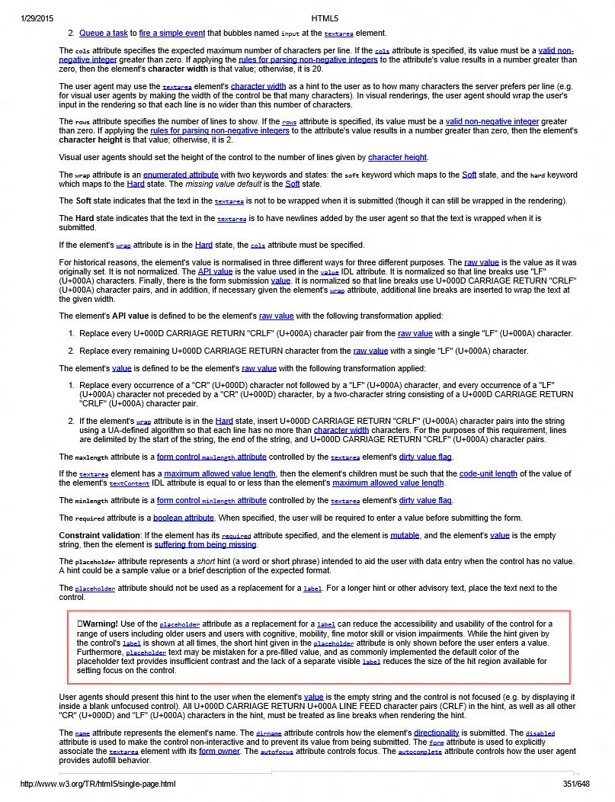
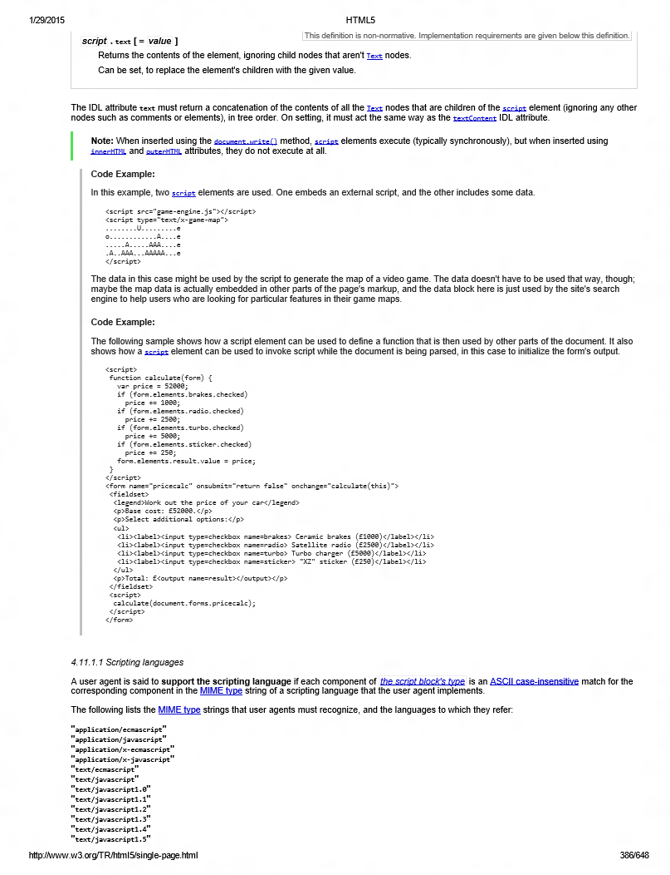
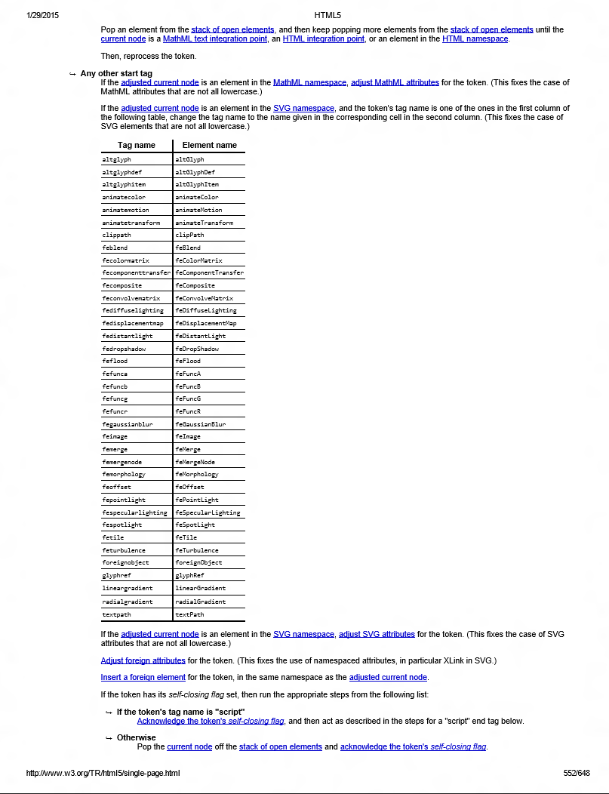
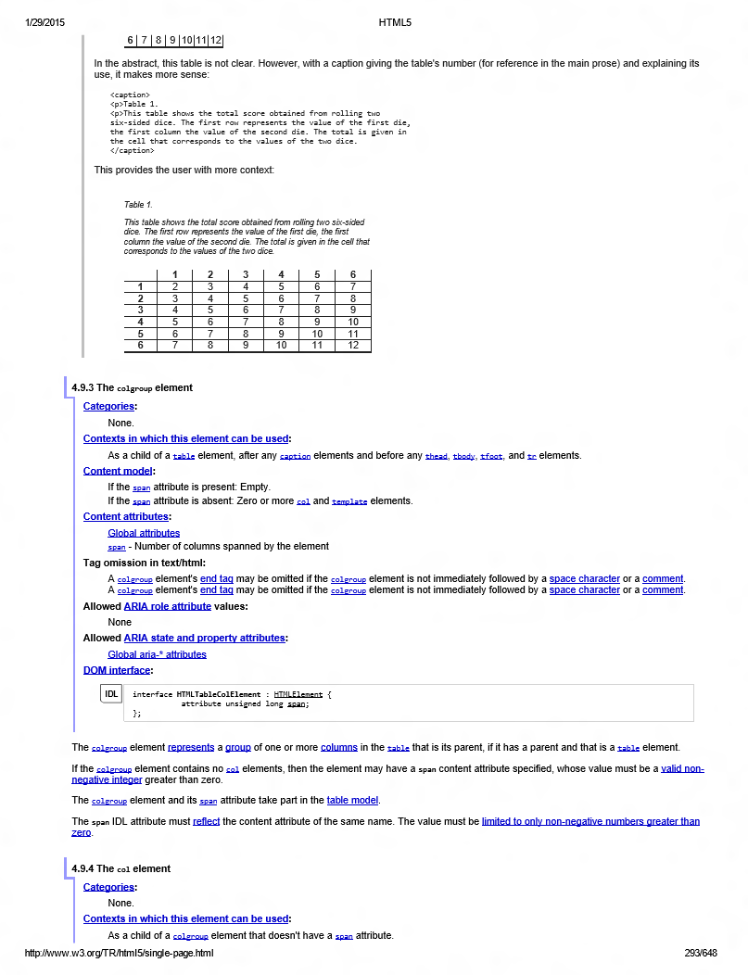
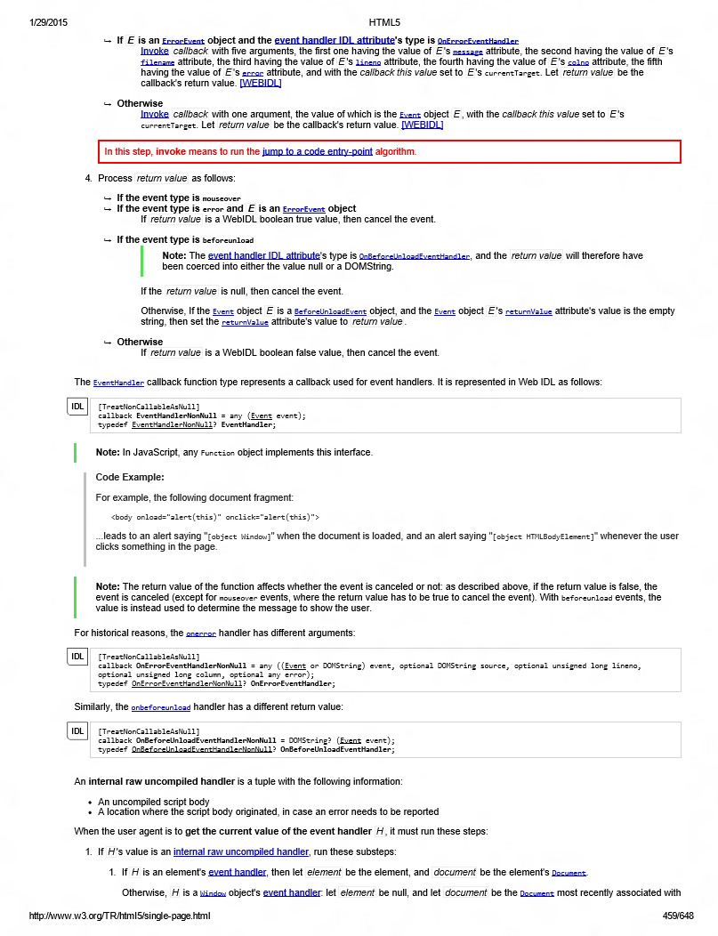
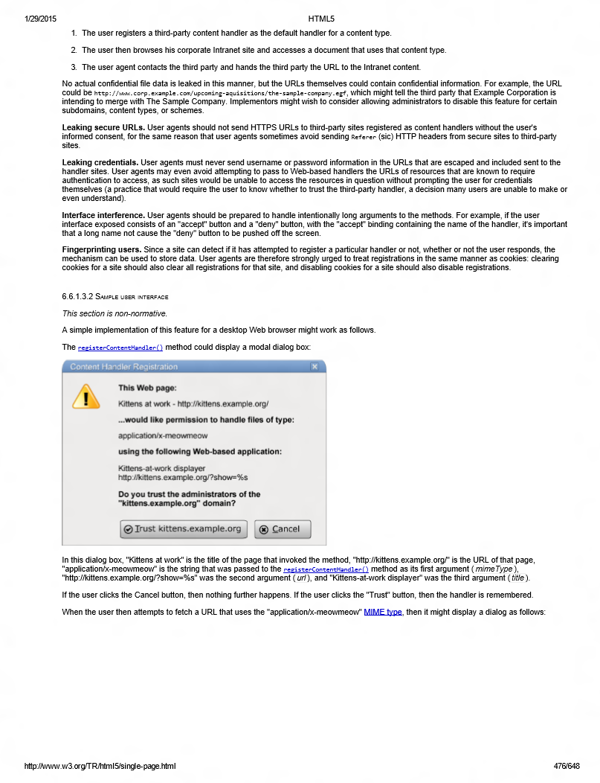
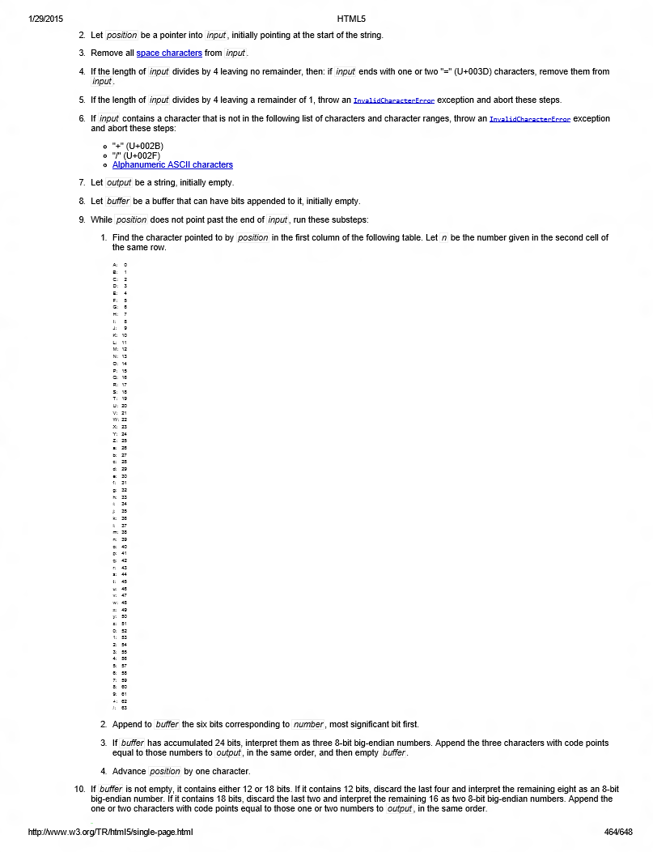
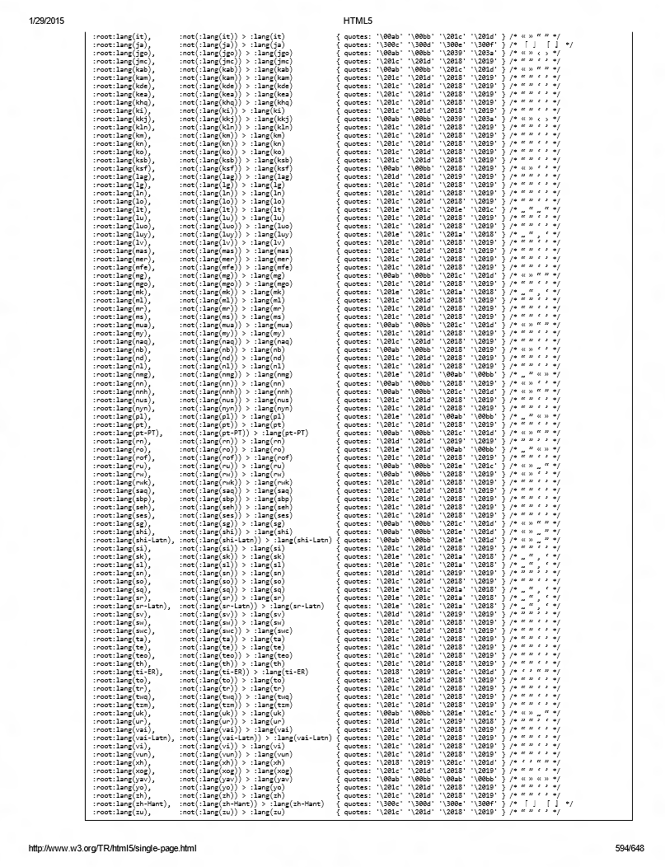
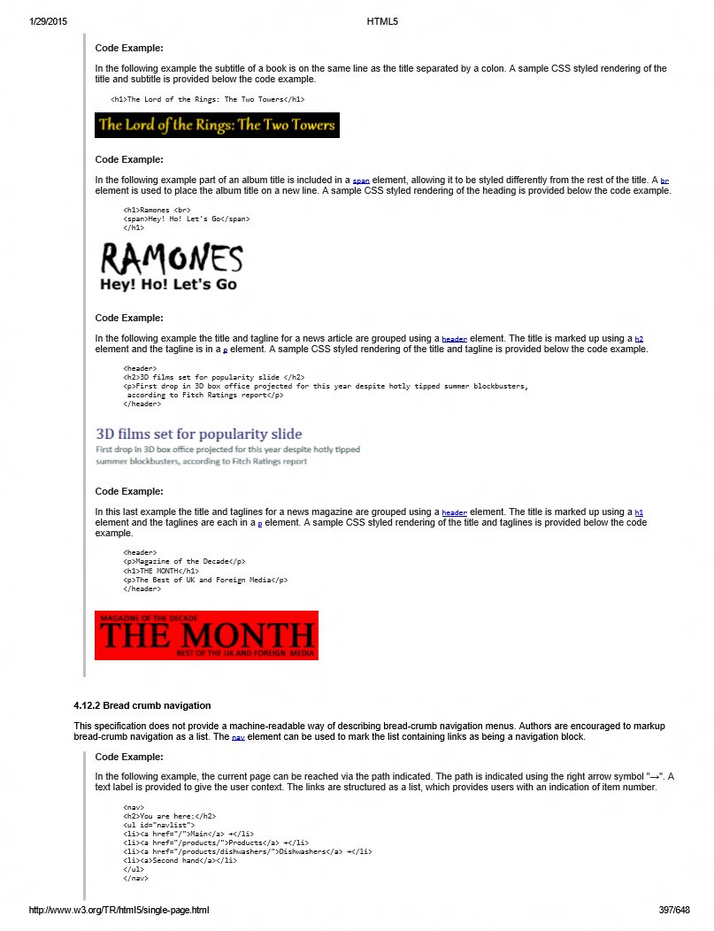
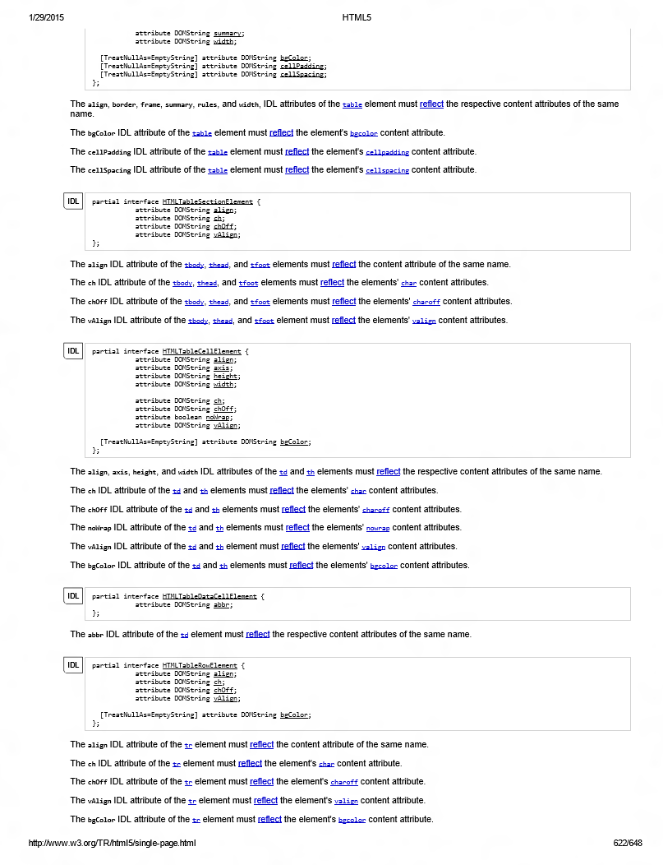
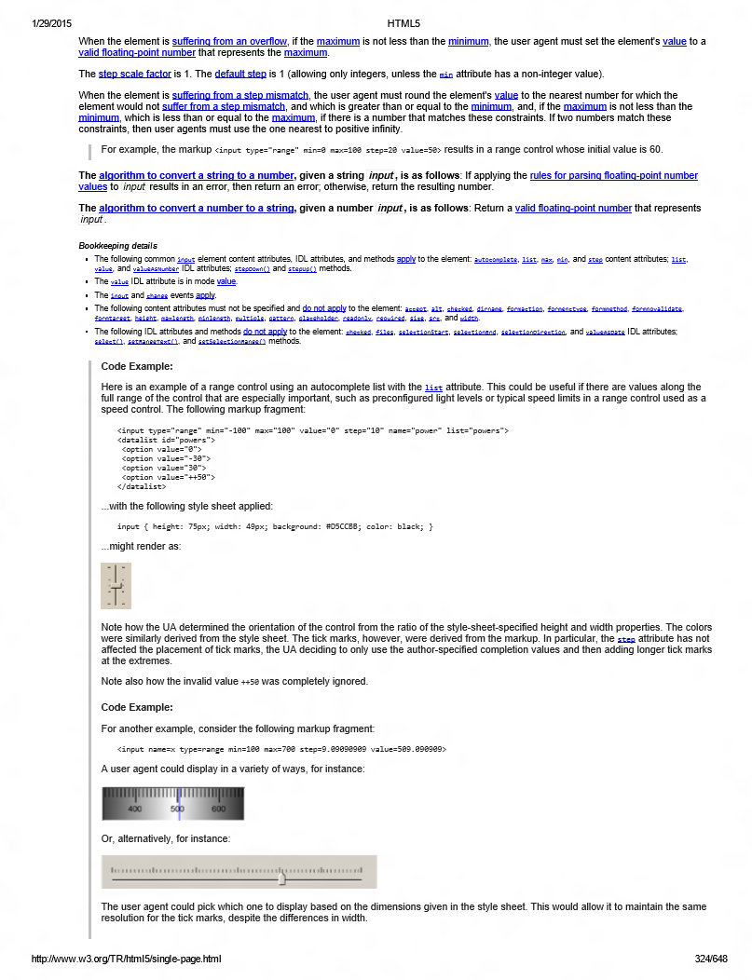
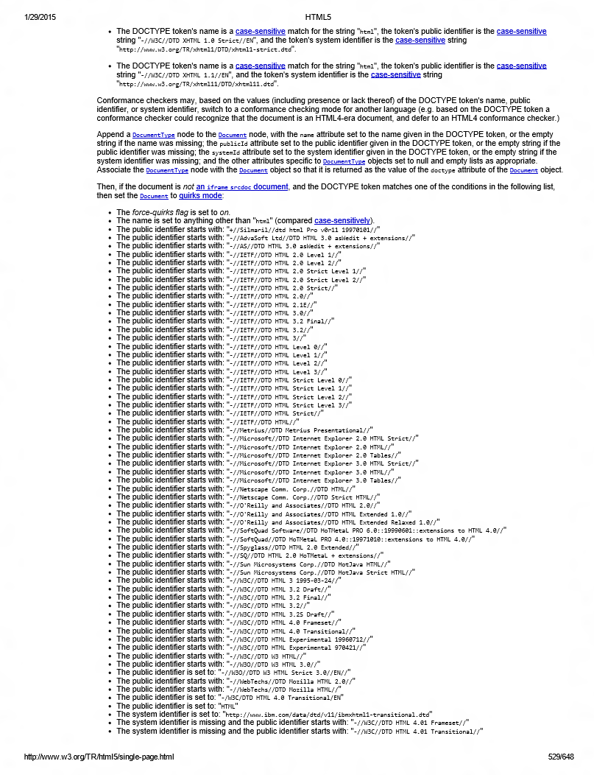
Making a web browser: Specifications

Slide 21
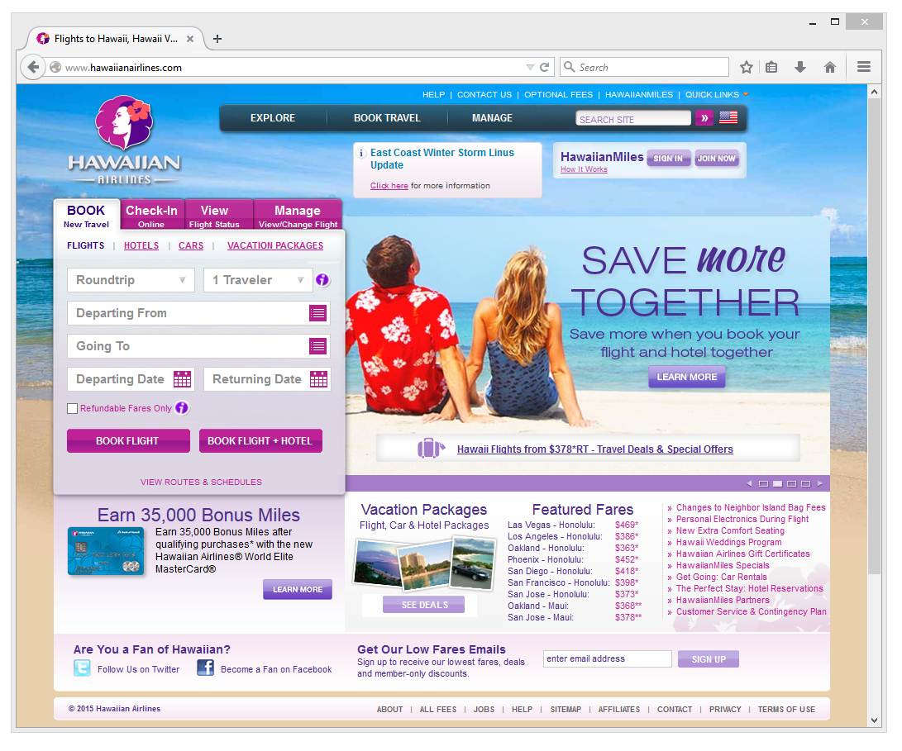
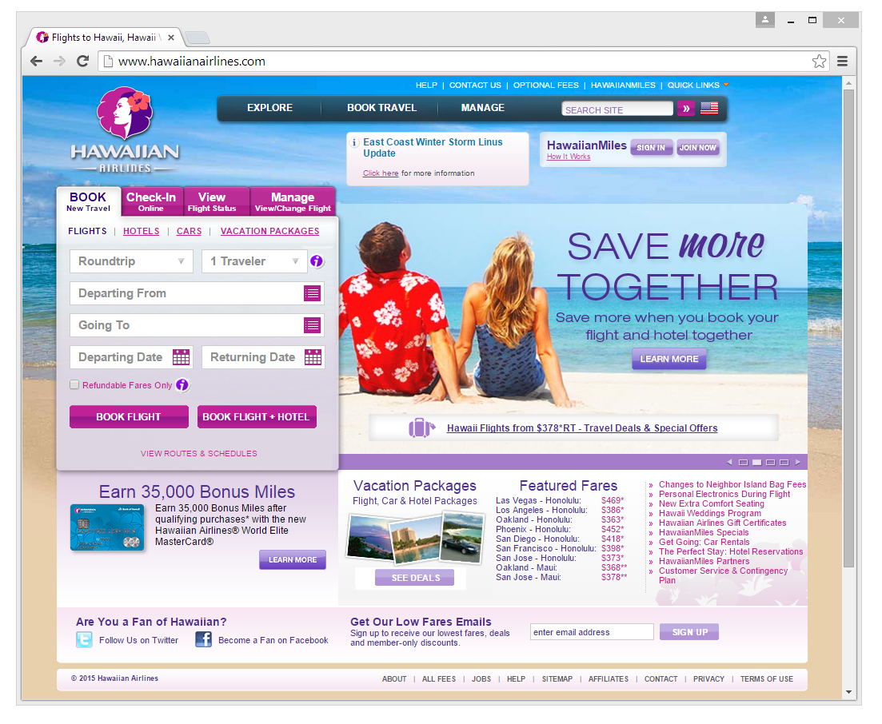
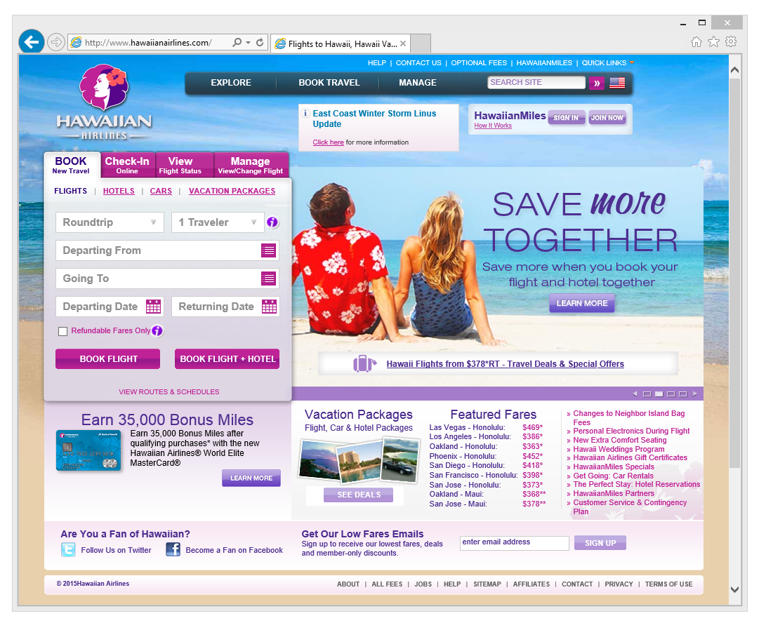


Slide 22
Interoperability means the web “just works”
W3C – what developers do should guide the spec.
Update and align specifications, libraries, other browsers
If standard defines an API behavior but all other browsers behave differently, is it a standard?

Slide 23
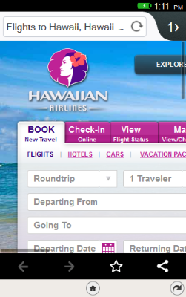
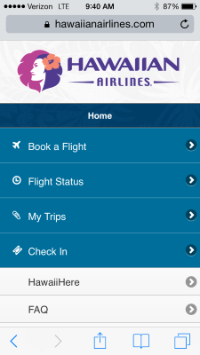
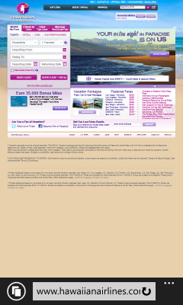


Slide 24
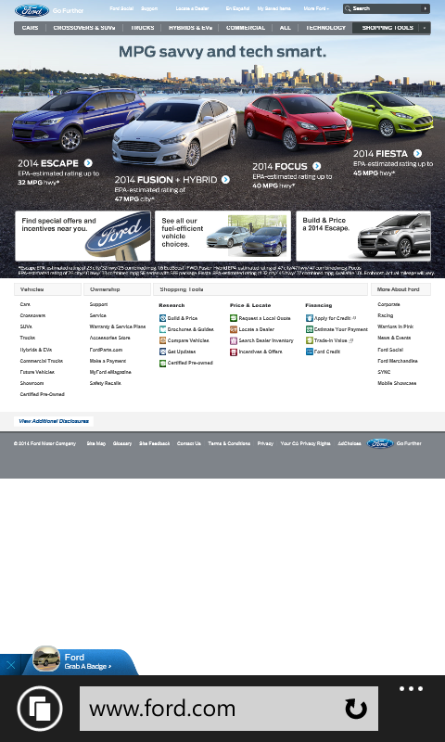
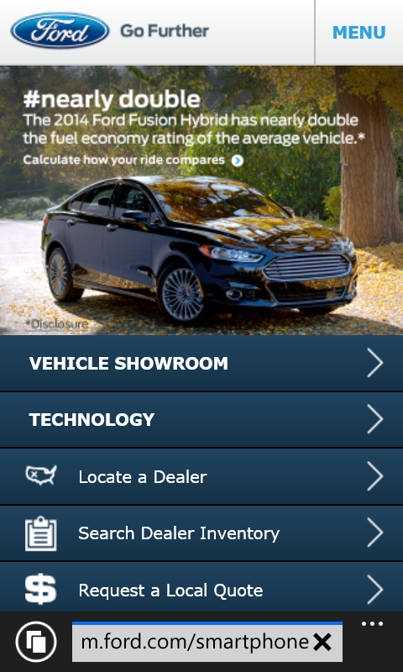
Mobile User Agent String Issues
Problem: Some web servers require ‘Android’ or ‘iPhone’ tokens before serving mobile content.
‘Skeleton key’ user agent: Mozilla/5.0 (ARM; Mobile) like Android) like iPhone OS 7_0_3 Mac OS X WebKit/537.36 (KHTML, like Gecko) Chrome/32.0.1700.99 Mobile Safari /537.36

Slide 25




User-Agent Strings
Mozilla/5.0 (Windows NT 10.0; WOW64; rv:39.0) Gecko/20100101 Firefox/39.0
Mozilla/5.0 (Macintosh; Intel Mac OS X 10_10_1) AppleWebKit/600.1.25 (KHTML, like Gecko) Version/8.0 Safari/600.1.25
Mozilla/5.0 (Windows NT 10.0; WOW64) AppleWebKit/537.36 (KHTML, like Gecko) Chrome/44.0.2403.89 Safari/537.36
Mozilla/5.0 (Windows NT 10.0; Win64; x64) AppleWebKit/537.36 (KHTML, like Gecko) Chrome/42.0.2311.135 Safari/537.36 Edge/12.10240

Slide 26
User-Agent Strings
Mozilla/5.0 (Windows NT 10.0; WOW64; rv:39.0) Gecko/20100101 Firefox/39.0
Mozilla/5.0 (Macintosh; Intel Mac OS X 10_10_1) AppleWebKit/600.1.25 (KHTML, like Gecko) Version/8.0 Safari/600.1.25
Mozilla/5.0 (Windows NT 10.0; WOW64) AppleWebKit/537.36 (KHTML, like Gecko) Chrome/44.0.2403.89 Safari/537.36
Mozilla/5.0 (Windows NT 10.0; Win64; x64) AppleWebKit/537.36 (KHTML, like Gecko) Chrome/42.0.2311.135 Safari/537.36 Edge/12.10240

Slide 27



User-Agent Strings
Mozilla/5.0 (Windows NT 10.0; WOW64; rv:39.0) Gecko/20100101 Firefox/39.0
Mozilla/5.0 (Macintosh; Intel Mac OS X 10_10_1) AppleWebKit/600.1.25 (KHTML, like Gecko) Version/8.0 Safari/600.1.25
Mozilla/5.0 (Windows NT 10.0; WOW64) AppleWebKit/537.36 (KHTML, like Gecko) Chrome/44.0.2403.89 Safari/537.36
Mozilla/5.0 (Windows NT 10.0; Win64; x64) AppleWebKit/537.36 (KHTML, like Gecko) Chrome/42.0.2311.135 Safari/537.36 Edge/12.10240

Slide 28
if (Mobile)
window.mobileCheck = function() {
var check = false;
(function(a){if(/(android|bb\d+|meego).+mobile|avantgo|bada\/|blackberry|blazer|compal|elaine|fennec|hiptop|iemobile|ip(hone|od)|iris|kindle|lge |maemo|midp|mmp|mobile.+firefox|netfront|opera m(ob|in)i|palm( os)?|phone|p(ixi|re)\/|plucker|pocket|psp|series(4|6)0|symbian|treo|up\.(browser|link)|vodafone|wap|windows (ce|phone)|xda|xiino/i.test(a)||/1207|6310|6590|3gso|4thp|50[1-6]i|770s|802s|a wa|abac|ac(er|oo|s\-)|ai(ko|rn)|al(av|ca|co)|amoi|an(ex|ny|yw)|aptu|ar(ch|go)|as(te|us)|attw|au(di|\-m|r |s )|avan|be(ck|ll|nq)|bi(lb|rd)|bl(ac|az)|br(e|v)w|bumb|bw\-(n|u)|c55\/|capi|ccwa|cdm\-|cell|chtm|cldc|cmd\-|co(mp|nd)|craw|da(it|ll|ng)|dbte|dc\-s|devi|dica|dmob|do(c|p)o|ds(12|\-d)|el(49|ai)|em(l2|ul)|er(ic|k0)|esl8|ez([4-7]0|os|wa|ze)|fetc|fly(\-|_)|g1 u|g560|gene|gf\-5|g\-mo|go(\.w|od)|gr(ad|un)|haie|hcit|hd\-(m|p|t)|hei\-|hi(pt|ta)|hp( i|ip)|hs\-c|ht(c(\-| |_|a|g|p|s|t)|tp)|hu(aw|tc)|i\-(20|go|ma)|i230|iac( |\-|\/)|ibro|idea|ig01|ikom|im1k|inno|ipaq|iris|ja(t|v)a|jbro|jemu|jigs|kddi|keji|kgt( |\/)|klon|kpt |kwc\-|kyo(c|k)|le(no|xi)|lg( g|\/(k|l|u)|50|54|\-[a-w])|libw|lynx|m1\-w|m3ga|m50\/|ma(te|ui|xo)|mc(01|21|ca)|m\-cr|me(rc|ri)|mi(o8|oa|ts)|mmef|mo(01|02|bi|de|do|t(\-| |o|v)|zz)|mt(50|p1|v )|mwbp|mywa|n10[0-2]|n20[2-3]|n30(0|2)|n50(0|2|5)|n7(0(0|1)|10)|ne((c|m)\-|on|tf|wf|wg|wt)|nok(6|i)|nzph|o2im|op(ti|wv)|oran|owg1|p800|pan(a|d|t)|pdxg|pg(13|\-([1-8]|c))|phil|pire|pl(ay|uc)|pn\-2|po(ck|rt|se)|prox|psio|pt\-g|qa\-a|qc(07|12|21|32|60|\-[2-7]|i\-)|qtek|r380|r600|raks|rim9|ro(ve|zo)|s55\/|sa(ge|ma|mm|ms|ny|va)|sc(01|h\-|oo|p\-)|sdk\/|se(c(\-|0|1)|47|mc|nd|ri)|sgh\-|shar|sie(\-|m)|sk\-0|sl(45|id)|sm(al|ar|b3|it|t5)|so(ft|ny)|sp(01|h\-|v\-|v )|sy(01|mb)|t2(18|50)|t6(00|10|18)|ta(gt|lk)|tcl\-|tdg\-|tel(i|m)|tim\-|t\-mo|to(pl|sh)|ts(70|m\-|m3|m5)|tx\-9|up(\.b|g1|si)|utst|v400|v750|veri|vi(rg|te)|vk(40|5[0-3]|\-v)|vm40|voda|vulc|vx(52|53|60|61|70|80|81|83|85|98)|w3c(\-| )|webc|whit|wi(g |nc|nw)|wmlb|wonu|x700|yas\-|your|zeto|zte\-/i.test(a.substr(0,4)))check = true})(navigator.userAgent||navigator.vendor||window.opera);
return check; }

Slide 29
Please don’t do UA sniffing

Slide 30
Please don’t do UA sniffing Please avoid UA sniffing as much as possible
Always do feature detection
(If isolating a bug) Sniff for specific browser versions
Assume unknown browsers are good

Slide 31
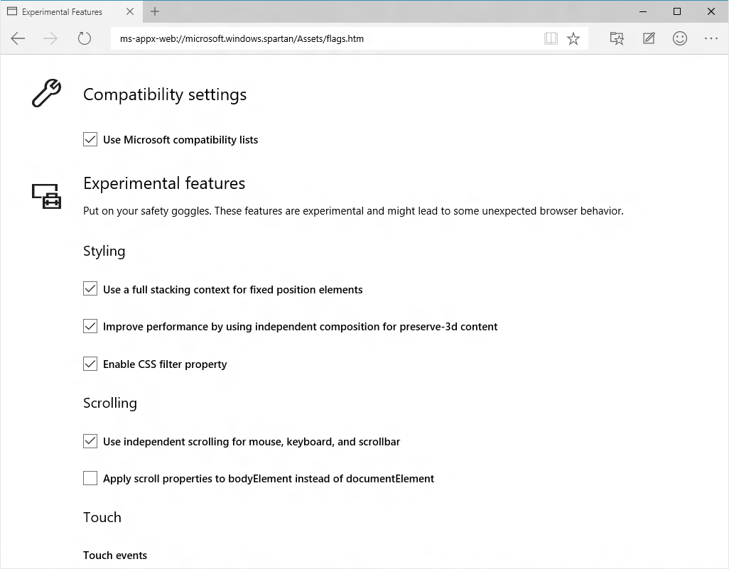
About:flags

Slide 32
Removing code (yay!)
attachEvent()
VML
X-UA-Compatible
IE Layout Quirks
VB Script
currentStyle
Conditional Comments
MS-prefixed Events

Slide 33
220k+
Unique LoC Removed
6 document modes
300+ APIs removed
300k+
Unique LoC Added
49 New Major Features
4200+ Interop Fixes

Slide 34
New features…

Slide 35
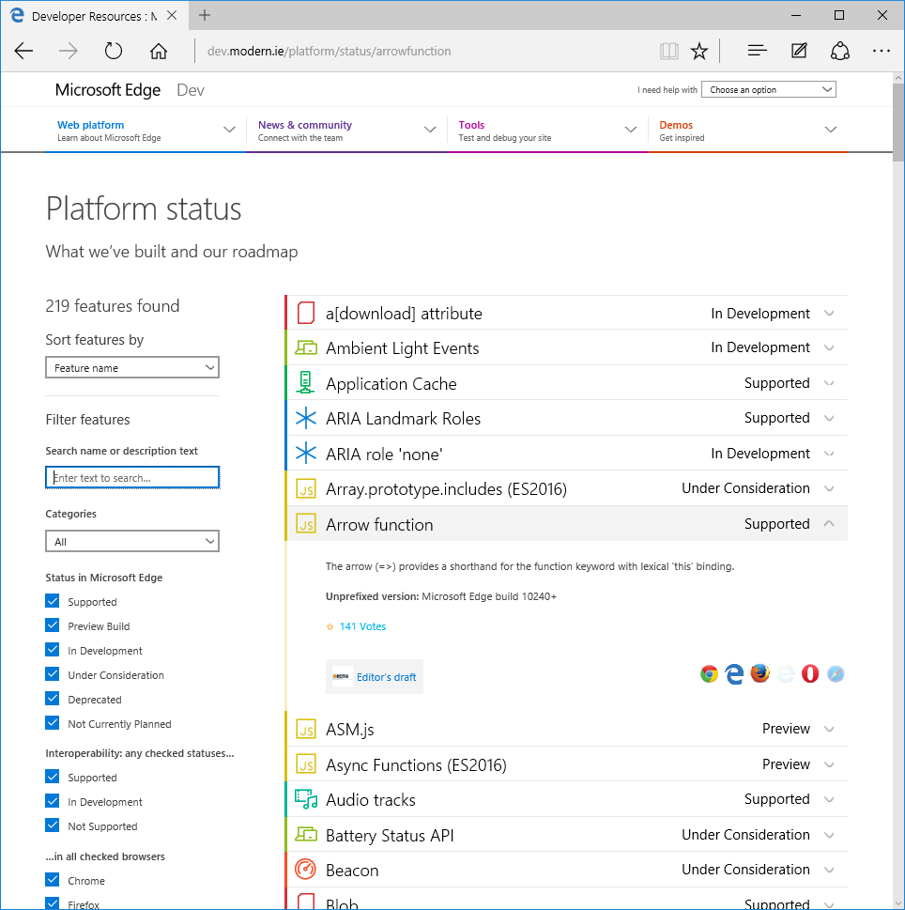
Planning in the open

Slide 36
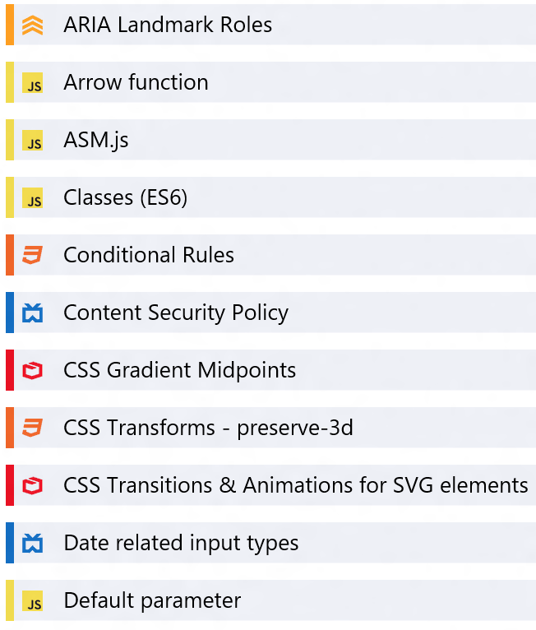
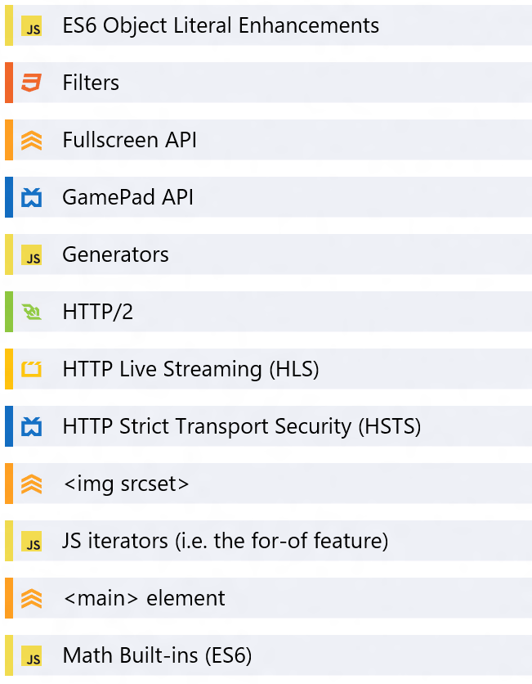
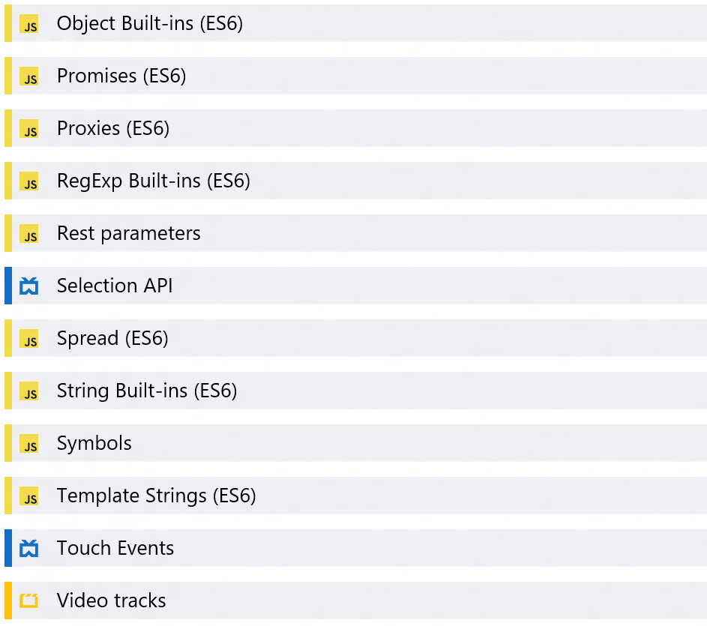
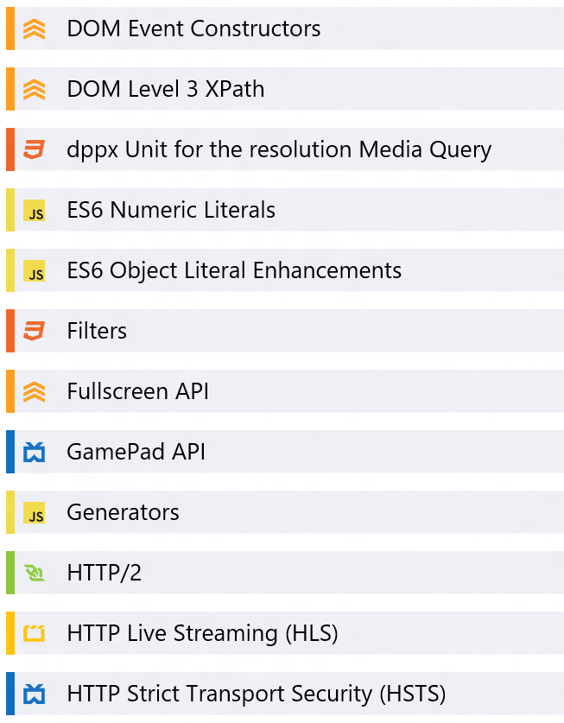
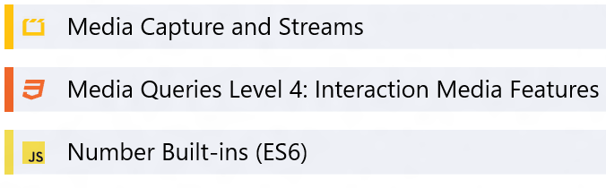
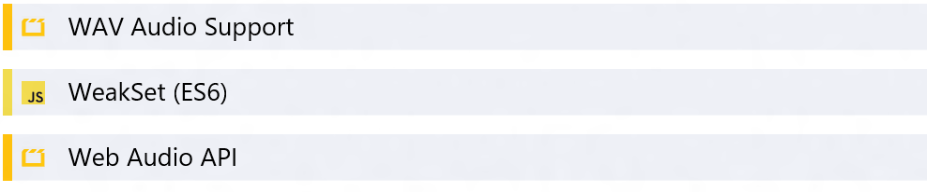
What’s available in Microsoft Edge now

Slide 37
And more…
3000+ Interoperability Fixes, Preserve-3d, Touch Events, CSS Filter Effects, DOM Clipboard Support, HTML Drag and Drop, Web Audio, CSS Position Sticky, CSS @supports, CSS Flexbox, HTML Beacon, WebDriver, IndexedDB, WebCrypto, Internation Mixed Languages Support, CSS Grid, CSS Variables, srcset, <picture> element, Web Workers Update, DOM4 Events, Font Loading, BDI, Cross-domain, HLS Manifest, Block Ellipsis, WAV, @rules, CSS Text(), CSS Border Logical, Logical Box Model, DOM Gamepad API, DOM FileSystem API, HTML <date> element, HTML <keygen> element, HTML <main> element, HTML <output> element, HTML <summary> element, HTML <detail> element, HTML <time> element, Native PDF, AppCache, SVG Hosting, Mutation Observers, HTML bidirectional, HTML Speech API, SVG animations, SVG transitions, SVG transforms, Canvas Path, Canvas Accessibility API, CSS Select Control, CSS Masking, CSS Clipping, Navigation Error Logging, CSS element(), CSS Shapes, ORTC, CSS Escape, Shared Workers, ES6 Modules, ES6 Promises, CSS Intrinsic & Extrinsic Sizing, Web Components, CSS Scoped Styles, HTTP 2.0, CSS Resize, WebGL, Canvas Blend Modes, CSS Interpolation, CSS Line Grid, CSS Line Box Contain, CSS Ruby, DOM Event Constructors, HTML <ol> Reverse, Server-Sent Events, Viewport APIs, Quota API, etc.

